Slide 1
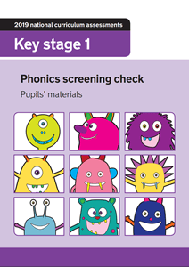
Phonics Screening Check Ashmount Primary School

Slide 2
Reading changes everything
Teach a child to read and keep that child reading and we will change everything.
And I mean everything.
Jeanette Winterson

Slide 3
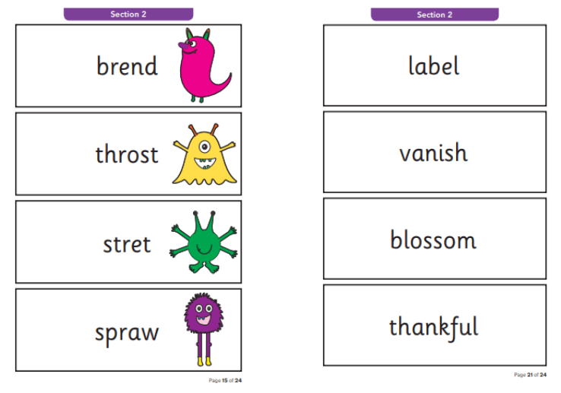
What is the Phonics Screening Check?
A word-reading assessment taken by all Year 1 children in June.
Children read 40 words with their teacher 1-to-1 in a quiet space.
It takes between two and five minutes per child.

Slide 4
When will it take place?
This year the PSC will take place throughout the week beginning Monday 6th June. This is the first week back after the half term break.
The PSC will take place before lunch and it’s so quick and relaxed that many children don’t even realise they have taken the assessment.

Slide 5
Real and Nonsense words
Some of the words that children read are real words and some of the words are alien or nonsense words.
These words check children’s knowledge of the graphemes they have been taught.
A grapheme is a sound written down.
The children need to know the graphemes in order to be able to read. They will have learnt these graphemes during their phonics lessons.

Slide 6
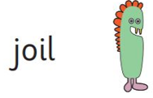
Real and Nonsense words
Alien or nonsense words are made up of graphemes that follow the phonics that children have been taught but don’t mean anything.
The purpose of alien/nonsense words is to assess if the children can recognise a grapheme in any word, rather than just words they are familiar with.
Children will need to read these words with the correct sounds to show they have understood the phonics they have been taught.

Slide 7
Scoring the check
The pass mark for the phonics screening check has always been 32 and we do not anticipate this to be different this year.
Children therefore need to read 32 words correctly out of 40 to pass the check.
If they do not manage to do this, they are given extra support and repeat the check again in Year 2.

Slide 8
Reporting the results
At Ashmount, we aim to make sure that every child learns to read accurately as quickly as possible so they are set up for success in school and in life.
Parents/Carers will be informed of the PSC outcome via letter along with the child’s end of year report.

Slide 9
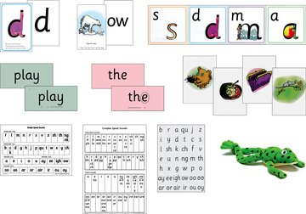
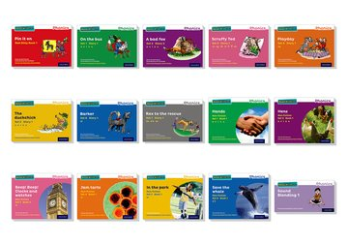
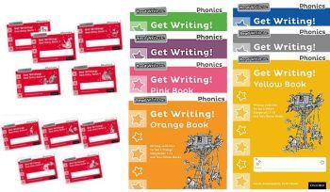
Daily Phonics Sessions
At Ashmount children are prepared for the PSC through their daily phonics lessons.
The daily lesson includes:
A speed sound session
A storybook session
A ‘Get Write’ session

Slide 10
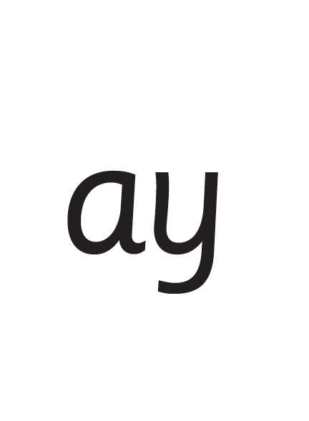
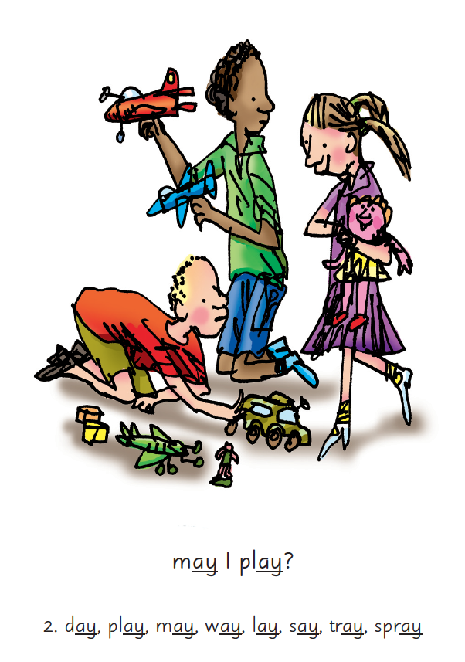
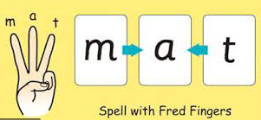
Speed Sound Session
Children are taught a new sound using a picture phrase to help them remember.
They ‘Fred Talk’ words with the sound in p l ay
They read alien words.
They review sounds they have been previously taught.
They spell words containing the sounds they are learning.

Slide 11
Storybook session
Children read green words. These are real words from the storybook. They read them using the routine ‘Special Friends’, ‘Fred Talk’, read the word’.
They read these words more than once, on more than one day, so they are able to read them speedily when they read their storybook.
Children read their storybooks with a partner, answering questions and retrieving information.

Slide 12
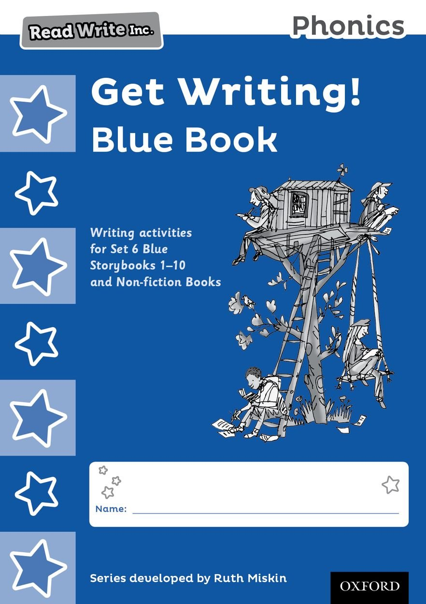
Get Write session
Children use the storybook they have been reading as a stimulus for writing.
They learn to memorise, compose and write sentences as well as short texts across a range of genres.
They are encouraged to use ‘Fred Fingers’ to spell words with the sounds they already know.

Slide 13
What can you do to support your child?
Ensure they are in school everyday.
Ensure they read regularly at home – short daily reading of their book-bag book is better than longer, less frequent reading.
3. Use ‘Special Friends’, ‘Fred Talk’,
‘Read the word’ to read words.
4. Discuss the story and encourage their storyteller voice.
Practise reading sounds speedily.

Slide 14
10 things your child learns when you read aloud stories and poems every day
Sustain attention
Appreciate rhythm and rhyme
Build pictures in their minds from the words on the page
Understand humour and irony
Use new words and phrases in different contexts - and later in writing
Learn new vocabulary and knowledge of the world
Think about characters’ feelings and use appropriate voices
Follow a plot with all its twists and turns
Understand suspense and predict what’s about to happen next
Link sentences and ideas from one passage to the next

Slide 15
Free Video Tutorials (ruthmiskin.com)

Slide 16
Online resources available
Ruth Miskin Parents’ Page:
https://www.ruthmiskin.com/en/parents-copy-2/
Free e-books for home reading:
http://www.oxfordowl.co.uk/Reading/

Slide 17
Any other questions
Q&A

